Slide 1

Predicting the Price of a House in the LA Region
Springboard Data Science Intensive Capstone Project
By: Hoddy Mahon
7/3/18
Updated: 7/24/18

Slide 2
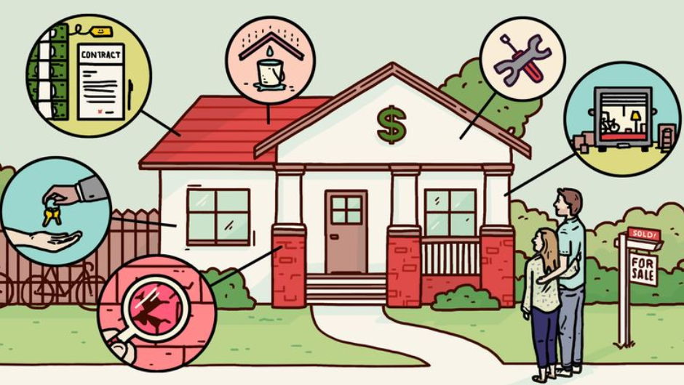
The Problem
Buying a home is a very expensive purchase and average Americans are not equipped with enough knowledge to know if they’re getting a fair price

Slide 3
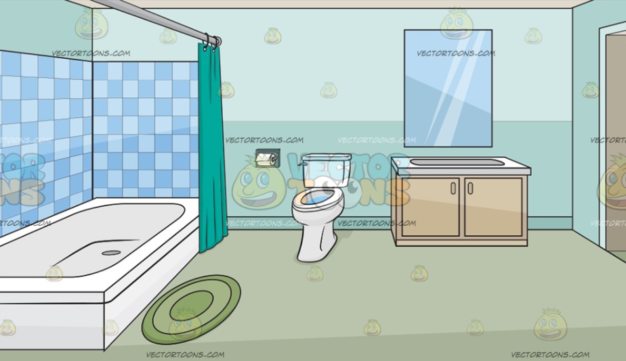
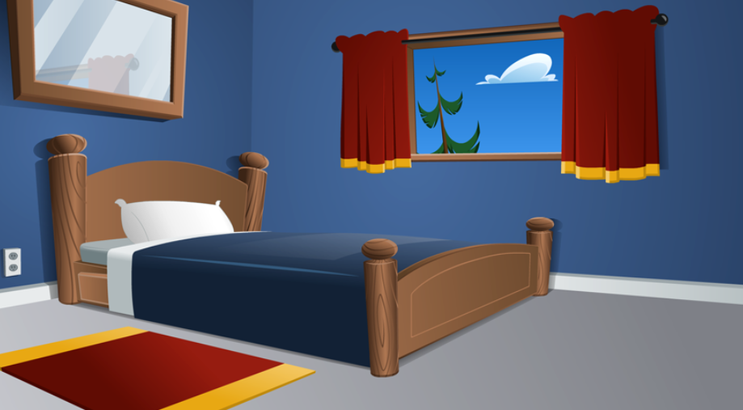


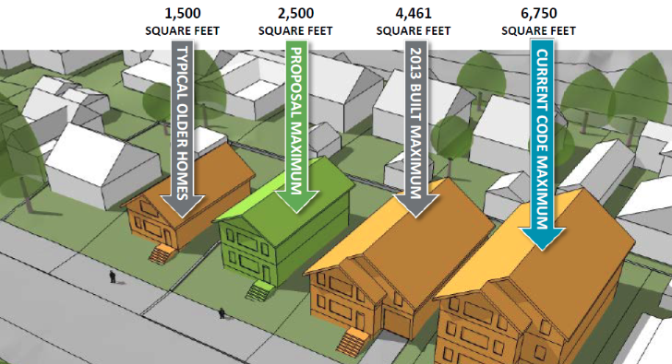
What factors might affect home valuations?
# of Bedrooms
# of Bathrooms
House size
Pool or no pool?
Location
Etc., etc.

Slide 4

Data Information
Data acquired in 2017
Data is from Zillow.com, an online real estate database company
Number of records – 2,985,217
Number of fields – 58
Data is only from 3 Southern California counties (Los Angeles, Orange and Ventura, California)

Slide 5
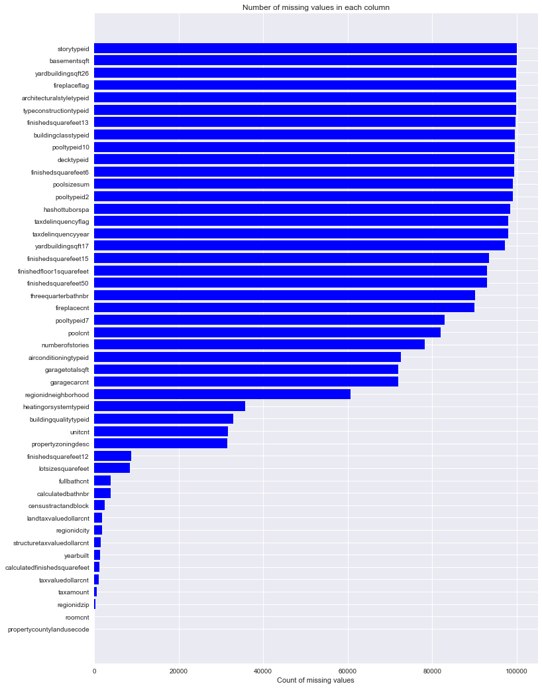
Feature Engineering – Null Values
Dealing with null values played a large a role in the feature engineering process
To the right is a count of how many null values were in the dataset per each feature
There were many features that had over 90% of null values

Slide 6
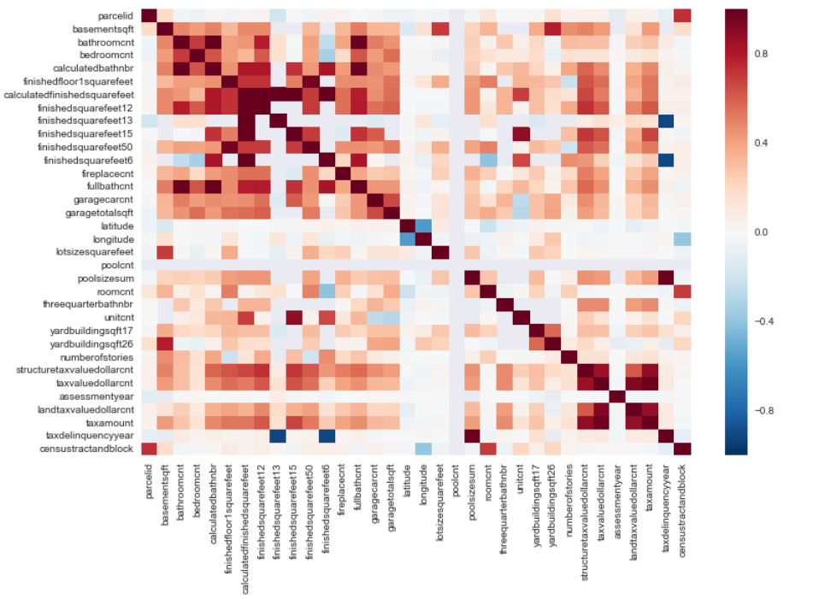
Feature Engineering – Feature Correlation
To the right is a heatmap showing how correlated features are with one another
Upon reviewing the data dictionary, sometimes these highly correlated features were the exact same thing!
Appropriately handling these features that were highly correlated with one another was another important piece of the feature engineering process
(Full version can be seen in the paper)

Slide 7
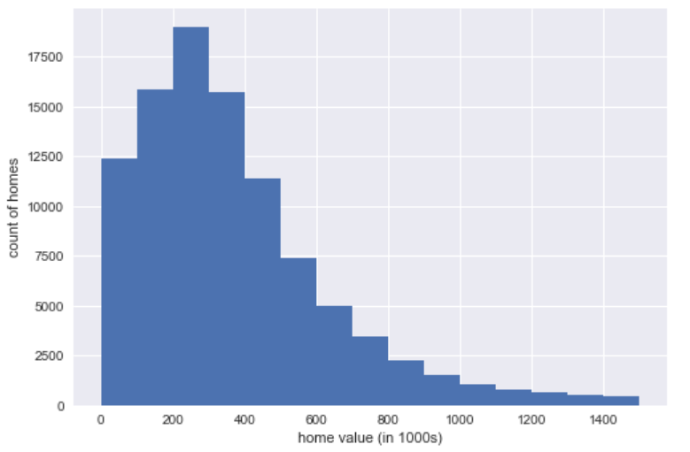
Data Exploration: Histogram of housing prices
The housing prices are skewed right. This makes sense logically as most of the houses are around the 100 – 500k valuation. However, there are a good amount of more expensive homes and mansions that skew the dataset to the right

Slide 8
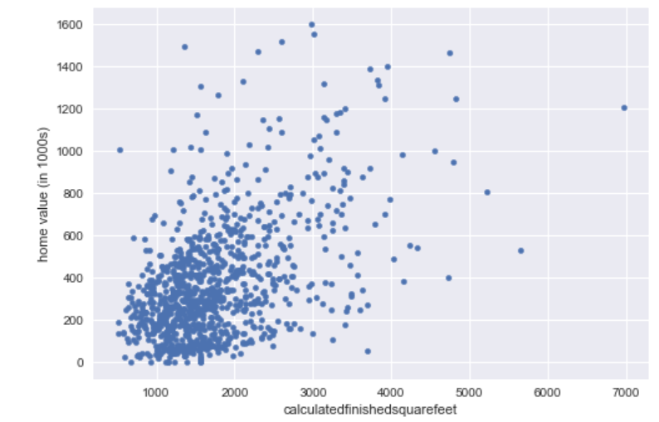
Data Exploration: Relationship between the square footage of the home and the home value
A fairly strong positive correlation exists between the square footage of the home and the home value

Slide 9
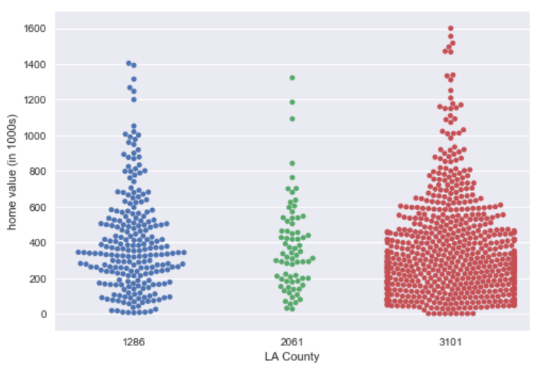
Data Exploration: Home values per the 3 LA counties found in the dataset
County 1286 probably has the highest average looking at the swarm plot
County 2061 does not possess many homes over $800k
County 3101 has the largest volume of records by a large amount

Slide 10
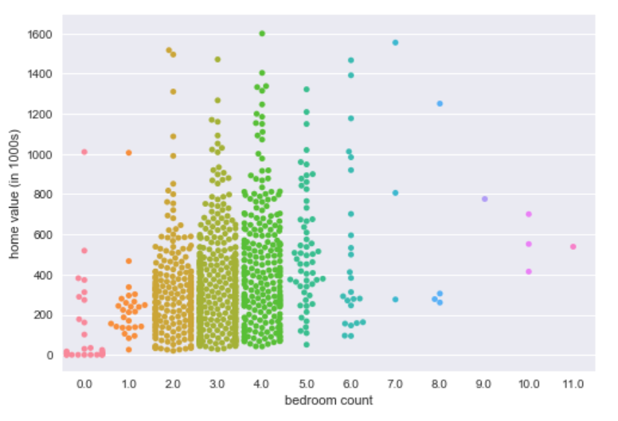
Data Exploration: Home values per the number of bedrooms
Most homes seem to have between 2-4 bedrooms. 4 bedroom homes appear to have the most amount of higher end homes

Slide 11
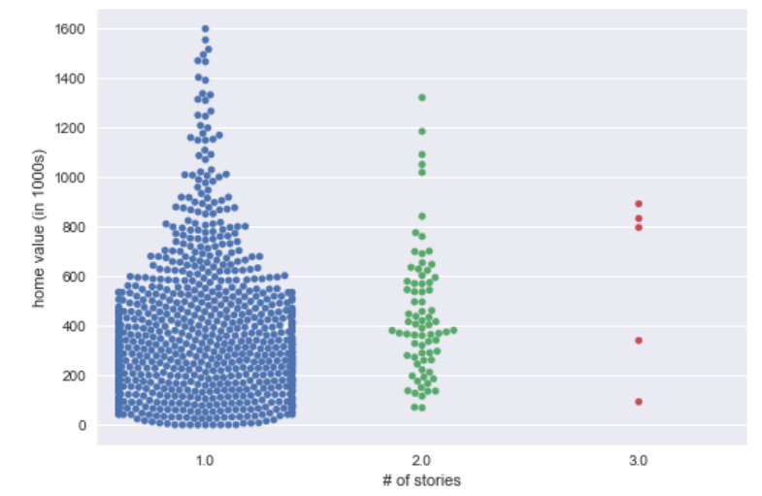
Data Exploration: Home values per the number of stories a home has
It doesn’t seem like three story houses are more expensive than one story houses. If anything, one story houses may be more expensive than three storied ones. It is a bit tough to tell considering the large volume of one story houses compared to three story houses however. Also, it appears that two story houses would have the highest average home value amongst the three values

Slide 12
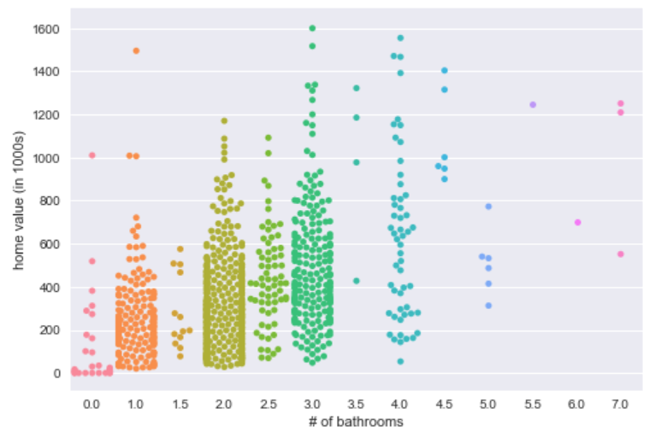
Data Exploration: Home values per the number of bathrooms in a home
If the home has over 3.5 bathrooms, there is a very high chance the home is above the mean house price. Meanwhile, if the home only has 1 bathroom, odds are it is below the mean house price

Slide 13
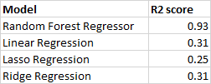
Machine Learning Model Selection
Split 70% of data into training set, 30% into test set
Ran training data through 4 baseline regression models and compared R² results
Regression models looked at were: Random Forest Regressor, Linear Regression, Lasso Regression, and Ridge Regression
Below are the outcomes of how each regression model performed
Cleary Random Forest Regressor performed the best

Slide 14
Random Forest Features and Advantages
The advantages of random forest are:
It is one of the most accurate learning algorithms available
It runs efficiently on large databases
It can handle thousands of input variables without variable deletion
It generates an internal unbiased estimate of the generalization error as the forest building progresses
It has an effective method for estimating missing data and maintains accuracy when a large proportion of the data are missing

Slide 15
Random Forest Disadvantages
The disadvantages of random forest are:
Random forests have been observed to overfit for some datasets with noisy regression tasks
For data including categorical variables with different number of levels, random forests are biased in favor of those attributes with more levels. Therefore, the variable importance scores from random forest are not reliable for this type of data

Slide 16
Modeling Steps
Split the data into training and test sets
Performed randomized search on the hyper parameters in order to tune them
3-fold cross validation was incorporated in this process
Ran the model with the tuned hyper parameters from the randomized search
Evaluated the model’s performance

Slide 17
Model Evaluation
R² score on training data = .81
R² score on test data = .66
Mean Squared Error = .43.
The R² indicates the percentage of the variance in the dependent variable that the independent variables explain collectively
The mean squared error tells us the average squared difference between the estimated values and what is estimated

Slide 18
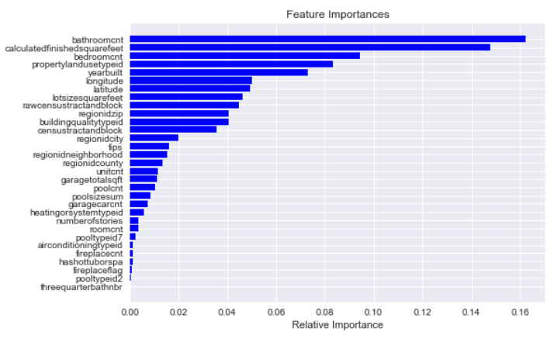
Feature Importance
Number of bathrooms, square footage, and number of bedrooms are the most important features

Slide 19
Model Assumptions
Because the actual price a home was sold for was not available in the dataset, the total tax assessed value of the parcel was used in this model as the dependent variable
Tax amount was used as the target variable when the target variable was null (1.1% of records)

Slide 20
Conclusion
Most of the features I had assumed were important (sq. footage, bathrooms, bedrooms), were proven to be important to the model
Location based features were not too important
Makes sense though because the data was from 3 neighboring California counties
One-Hot Encoding could have been used to incorporate the object data type features into the model
K-NN could have been used to fill in some of the missing data for some columns
Feature engineering is crucial in data having a solid model
There’s a lot still to learn in the field of data science, but I believe I have a very strong foundation thanks to Springboard

Slide 21
Thank you!

